Slide 1


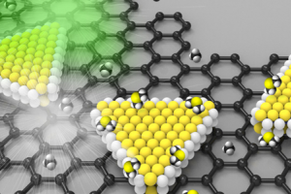
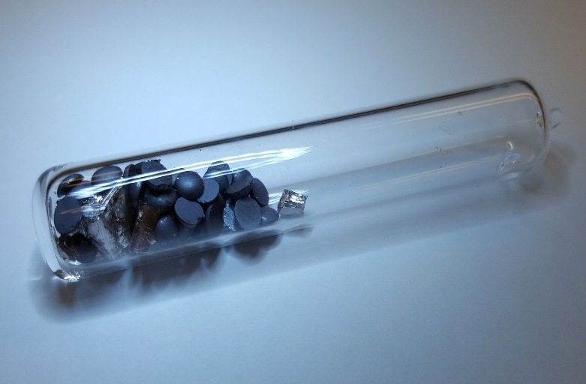
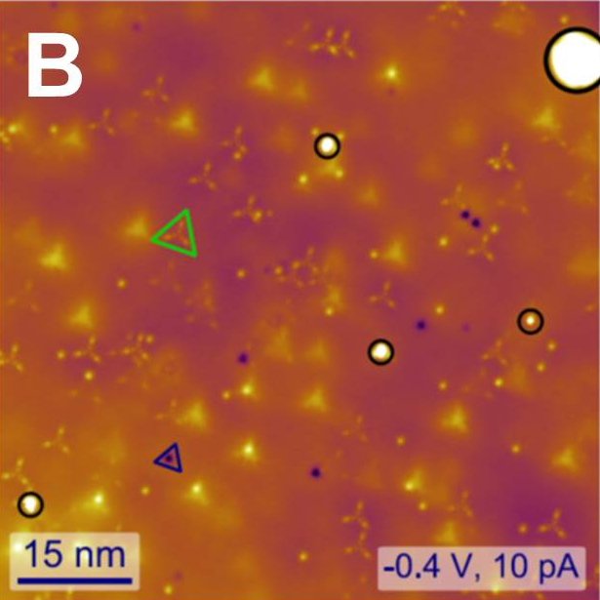
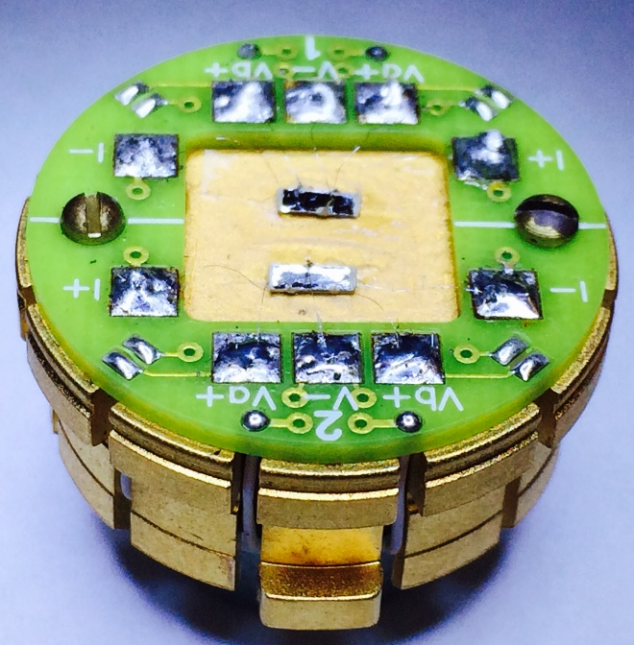
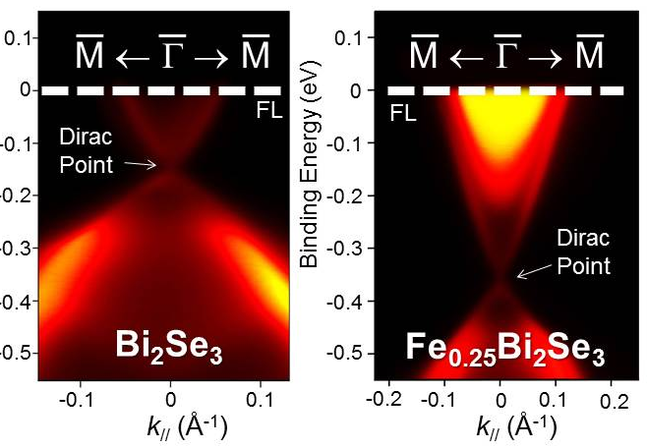
β-InSe by Seng Huat (Sam) Lee

Slide 2
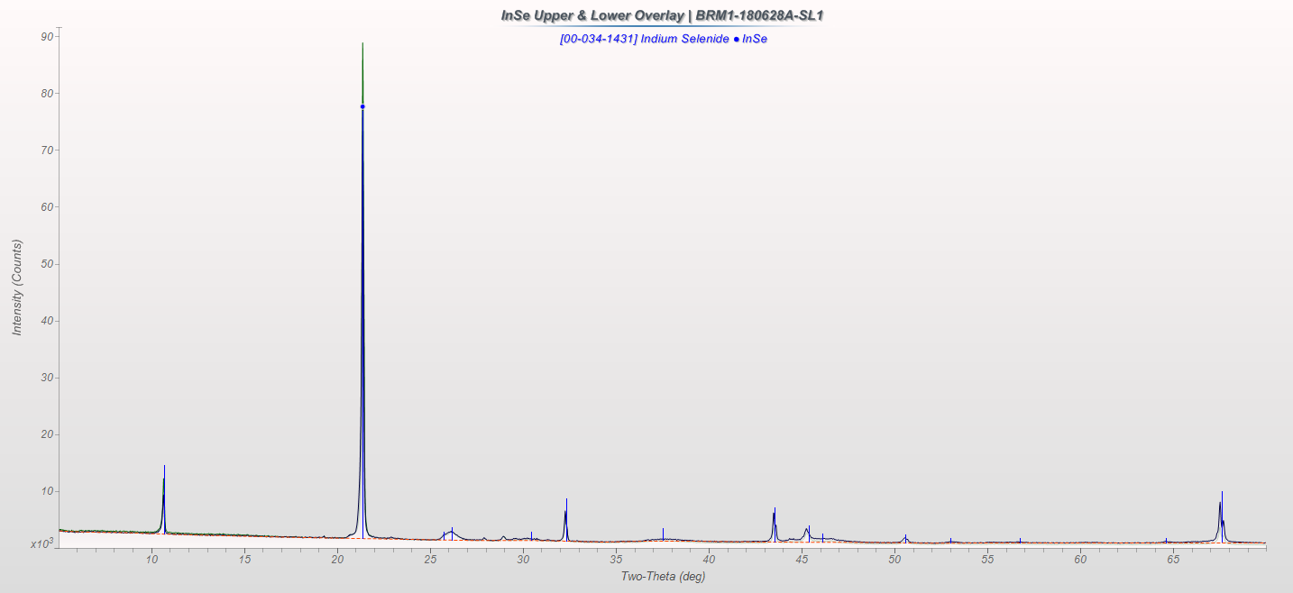
Powdered XRD pattern of InSe matched with the ICDD database PDF card 00-034-1431, β-InSe space group 194.
However, there are two impurity peaks at 27.89(1) and 28.94(2).

Slide 3
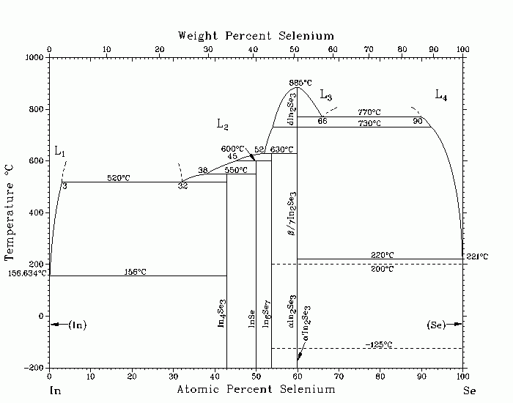
From the In-Se phase diagram, the possible impurity for the growth of InSe will be either In₄Se₃ and In₆Se₇.
Since the stronger reflected peak of In₄Se₃ are occurred at 28.92 and those two observed impurity peaks matched with In₄Se₃, it is clear evidence the secondary phase is In₄Se₃.
The PDF card for β-, γ-InSe, and In₄Se₃ are attached.

